Slide 1
LEGO Flash-drive
By Lawrence Melkulcok

Slide 2
Materials
Flash-drive
2 flat and 2 brick LEGO’s
DREMEL tool with grinder and drill
Sealant
Flat head screw driver (to split drive)
Optional:
Chain
Holed flat LEGO

Slide 3
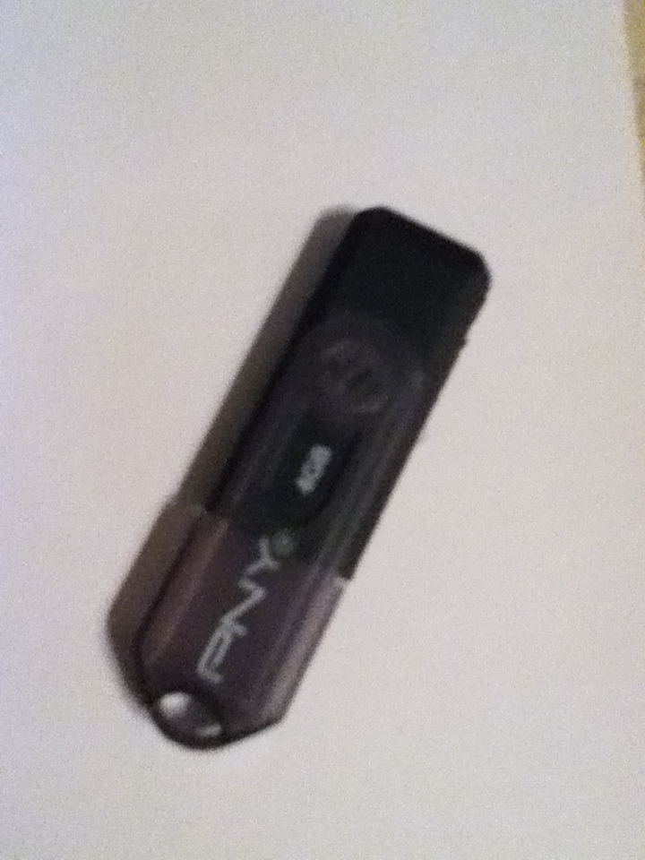
Step 1... Get a flash drive

Slide 4
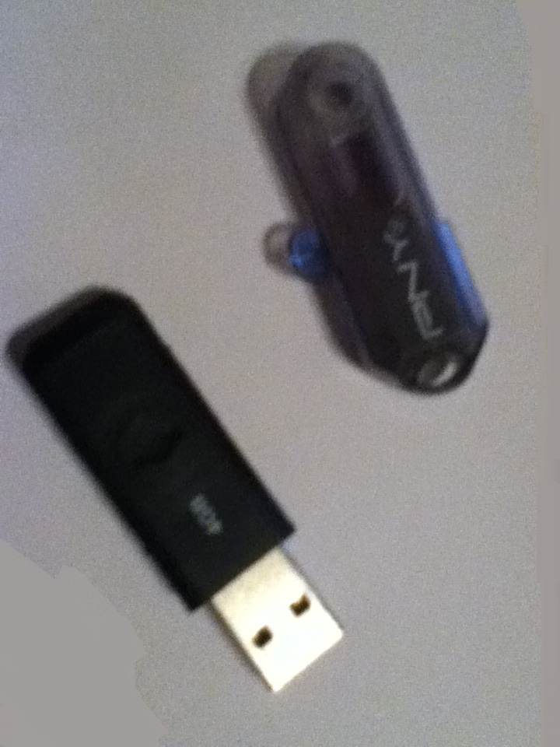
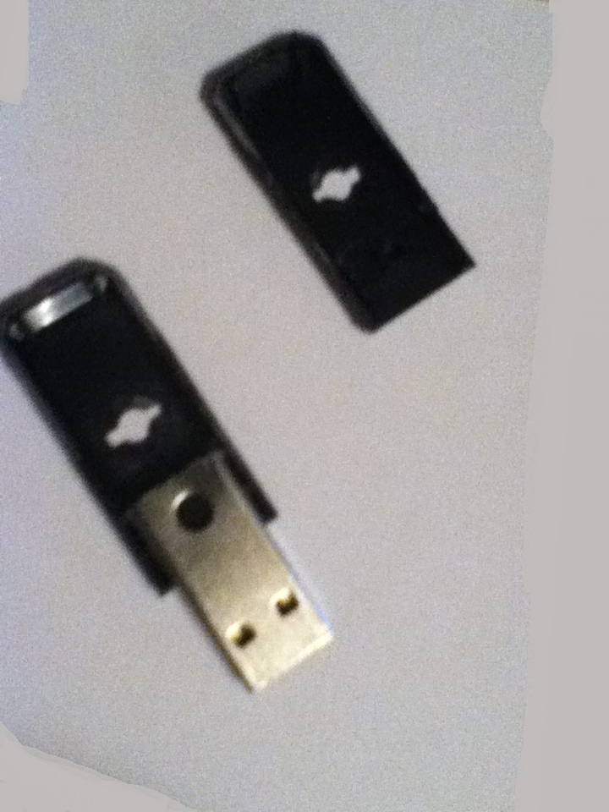
Step 2 … Split it open

Slide 5
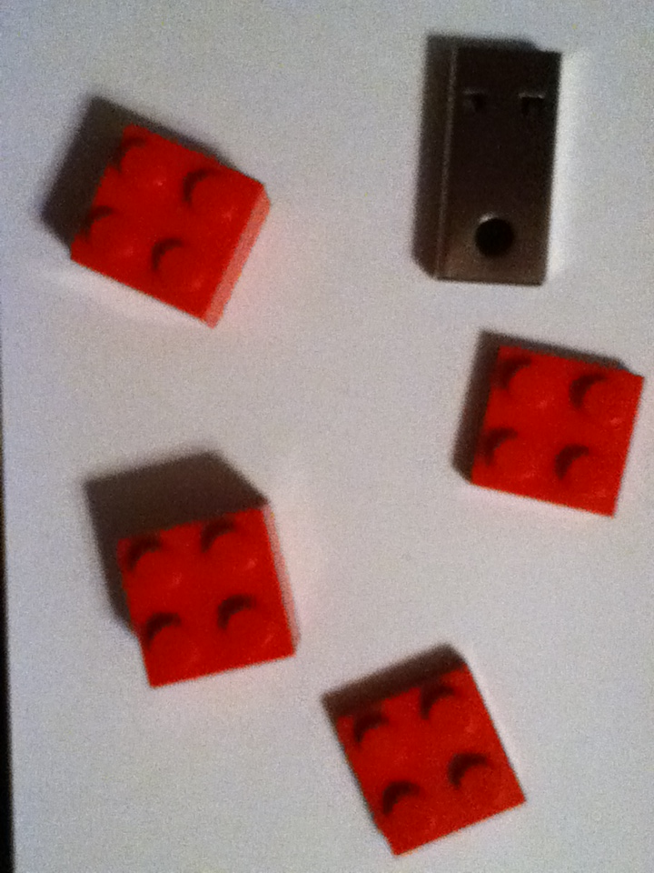
Step 3 … Get LEGO’s
2 Flats
2 Bricks

Slide 6
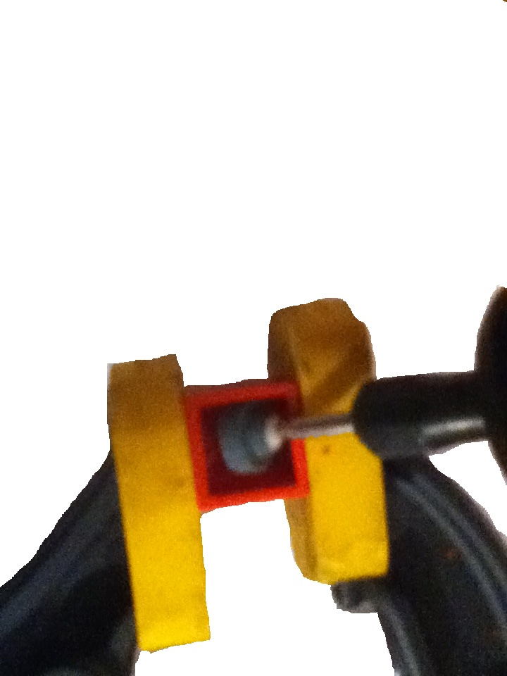
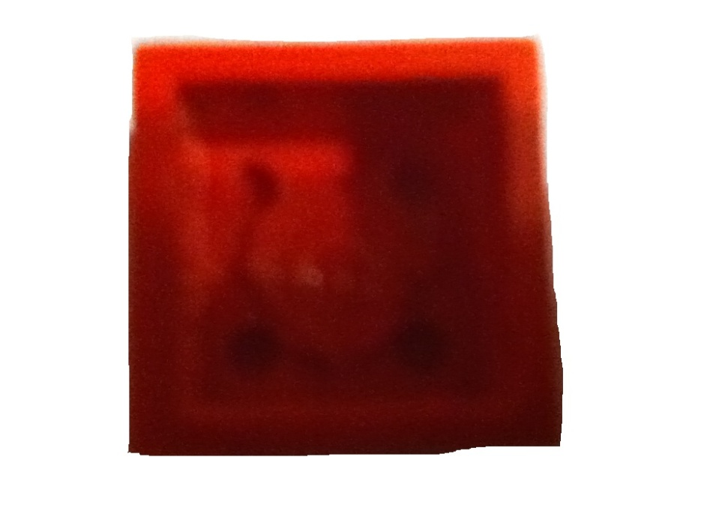
Step 4 … Grind away insides

Slide 7
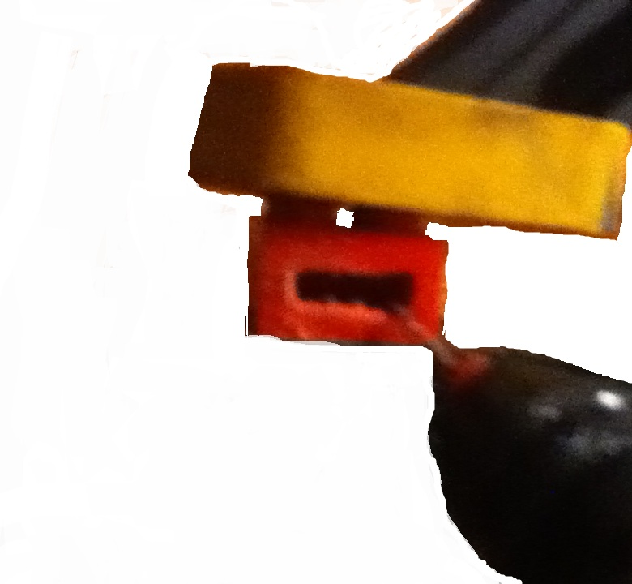
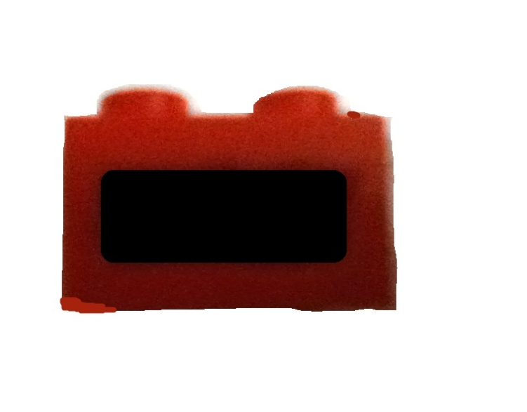
Step 5 … Cut a window

Slide 8
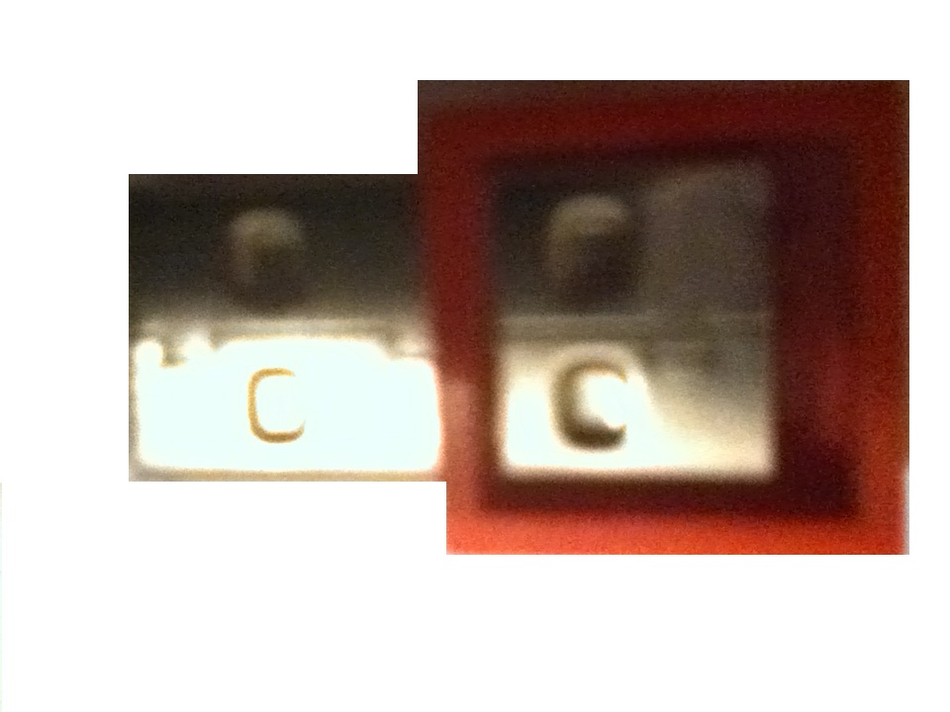
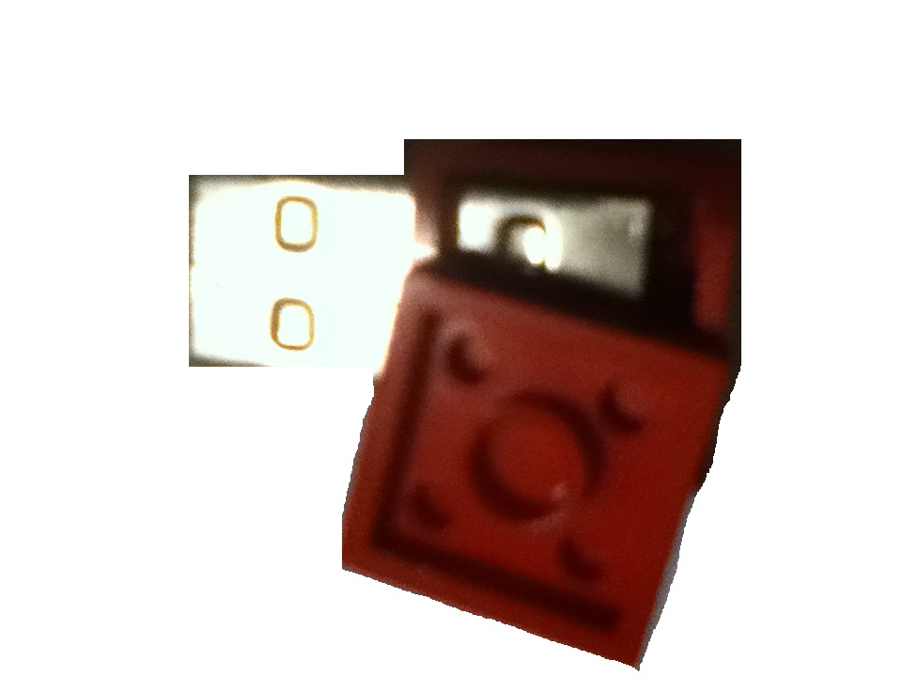
Step 6… Insert drive and seal

Slide 9
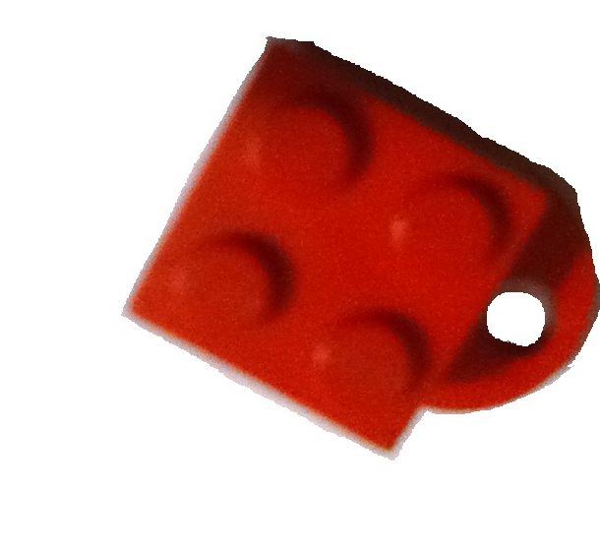
Step 7 … Make a lid
Just repeat
steps 6 and 7

Slide 10
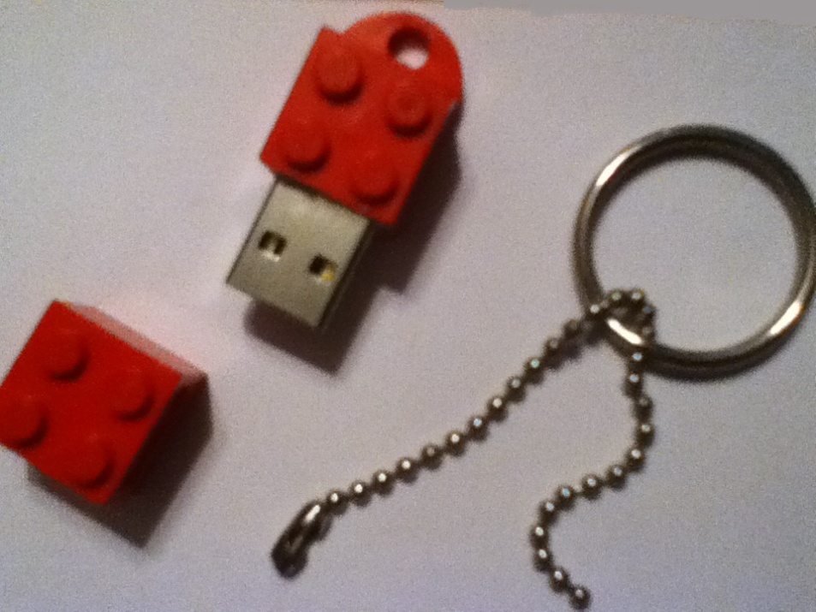
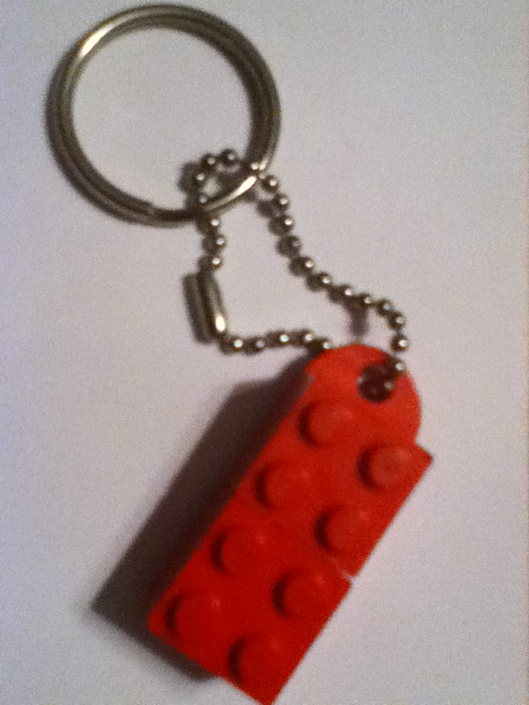
Step 8 … Assemble parts

Slide 11
Step 9 … Use and enjoy!
Thank you

