Slide 1

56/64 long x 44 wide total size for wood, carpet on sides/top
Left is 40wx36l cut down from 54x36. add cut ends to sides for cross support
“Pinned” removeable legs at corners.
Legs bolted and swing for storage, can have longer legs if back seats are ever fully removed. Middle has transverse mounted 2x6 for legs (removable) that sit on the hard high-ridge line of floor
Tie Board (2x6)
Right is 44wx20 + 8” cut down from 54x36. Can add 8” cut pieces back with hinges, if needed
Legs fold under for easier storage/transport
Pinned at middle joint to 2x6 tie board. Can add long legs to second make a table for use with cabin chairs or outside
56 long x 44 wide total size. If 8” hinge piece added then 64”
36 20
9.5” Leg
Optional
Ties to seat
holders on floor
13.5” leg
10.25” l;eg
Compact = 36 long x 44 wide total size

Slide 2
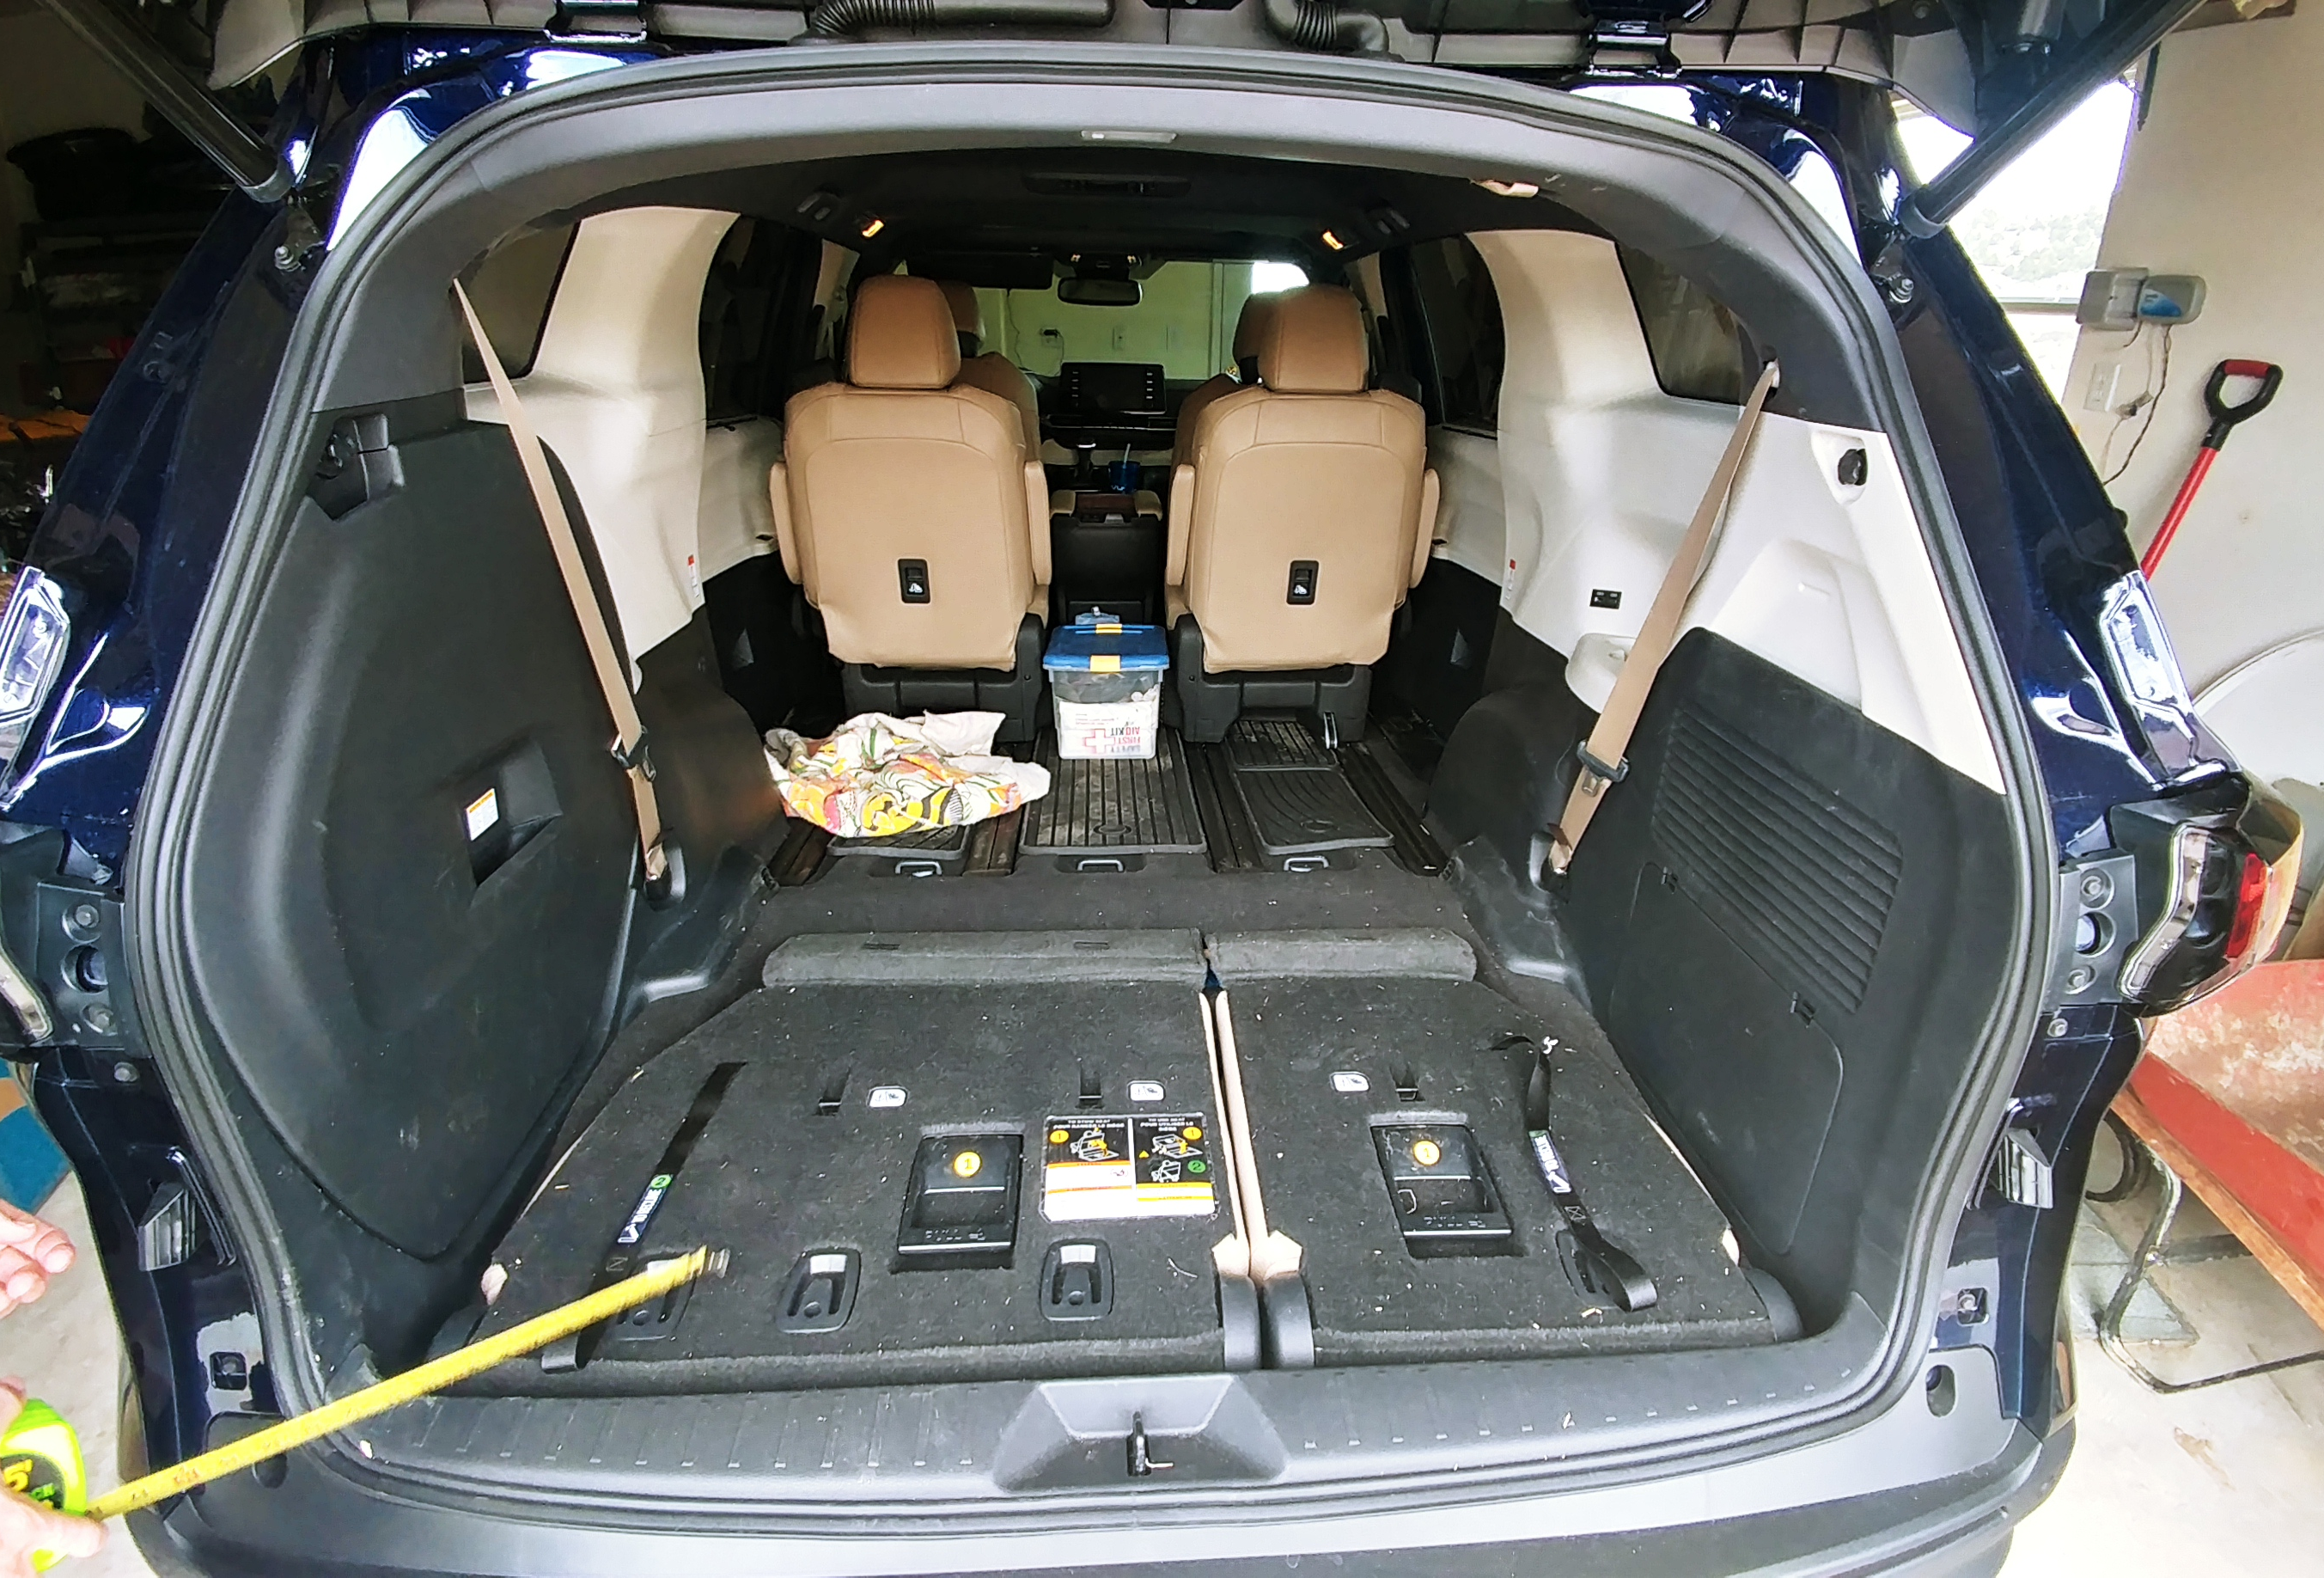
66: door-to-door space
56: frame-to-frame space
49” gap wall to wheelcover
42”air-vent2air vents”
72” folded chair
64” min usable chair
44” to max chair
4” minimum gap
for stable leg position
36” to High-ridge line
for stable mid-leg position. Note ridge is between air-vents

