Slide 1
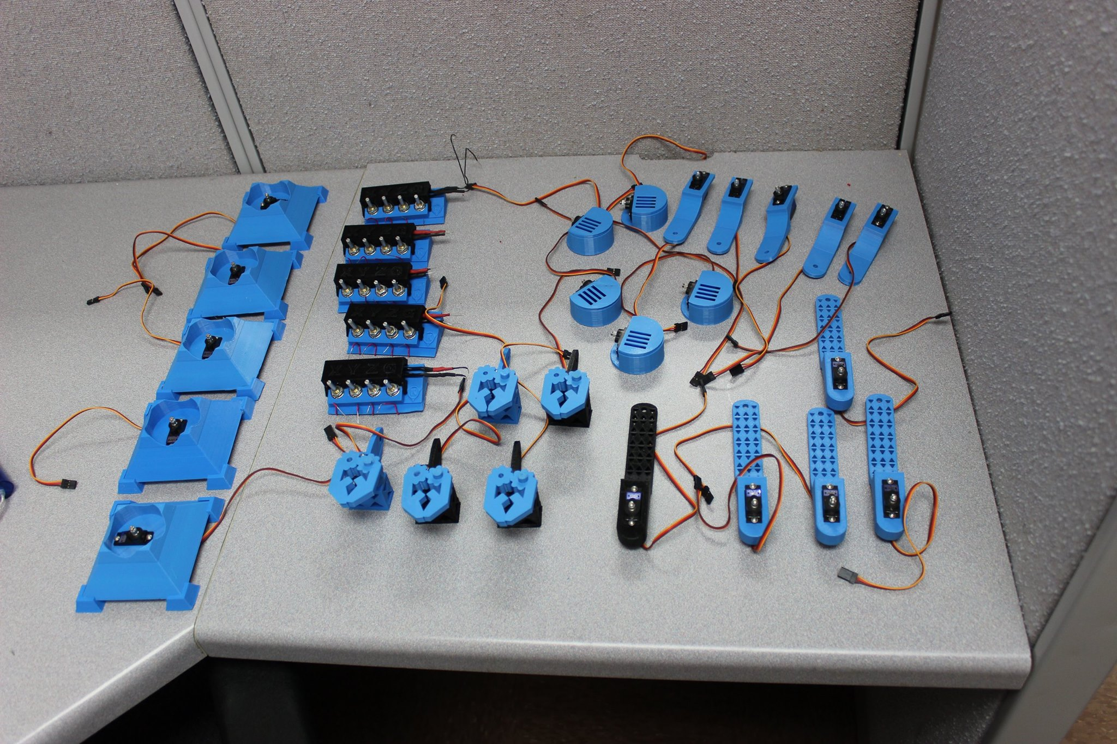
Circuits Specialists Robotic Arm
Designer: Khang Nguyen

Slide 2
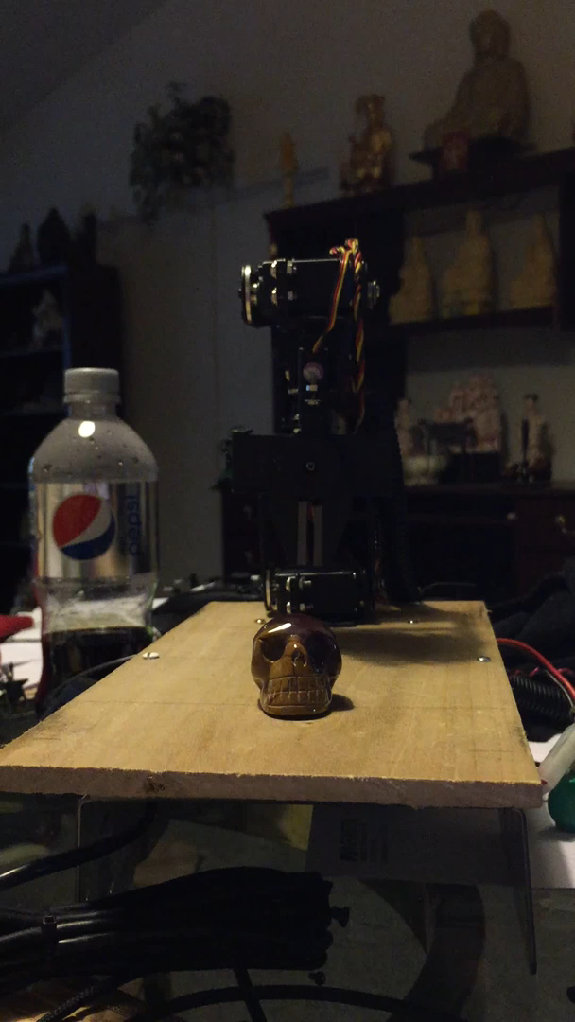
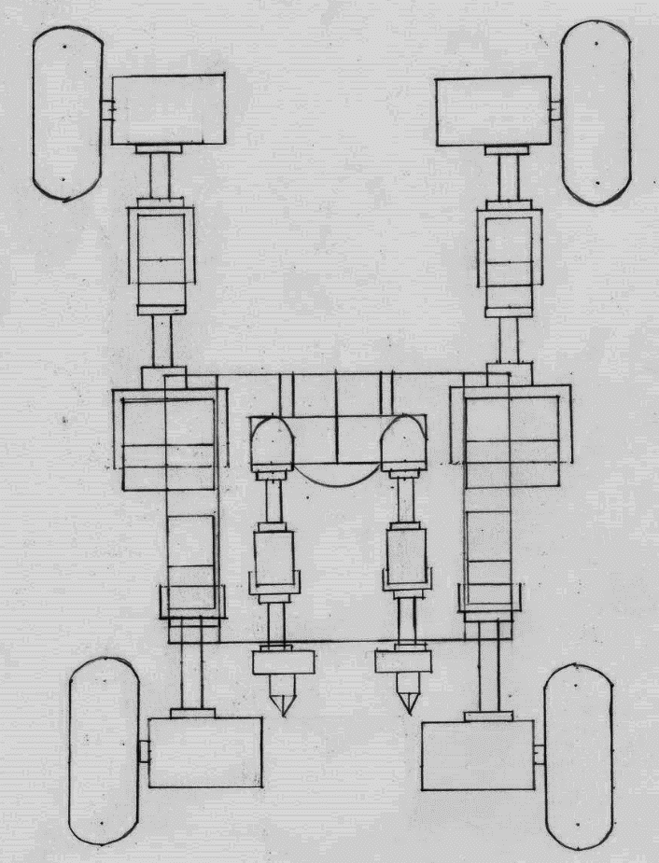
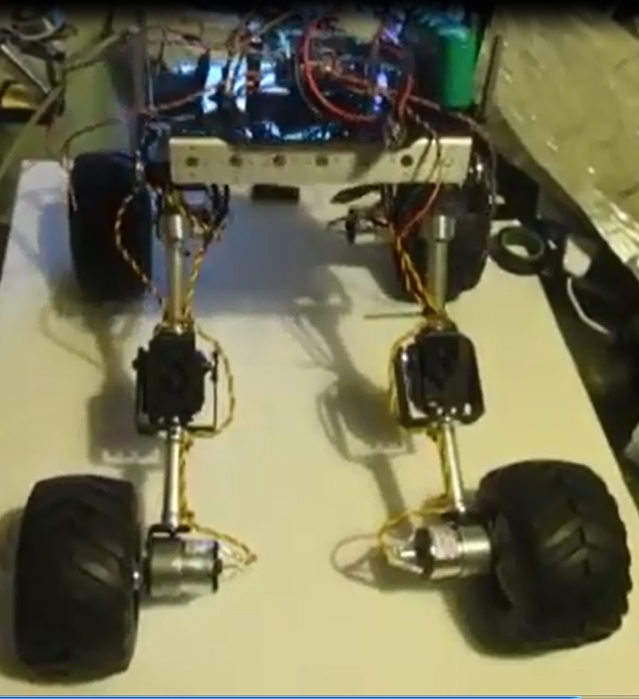
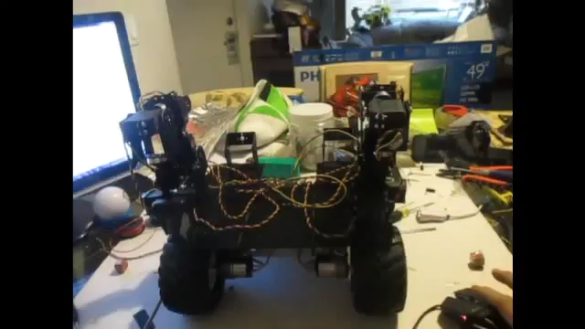
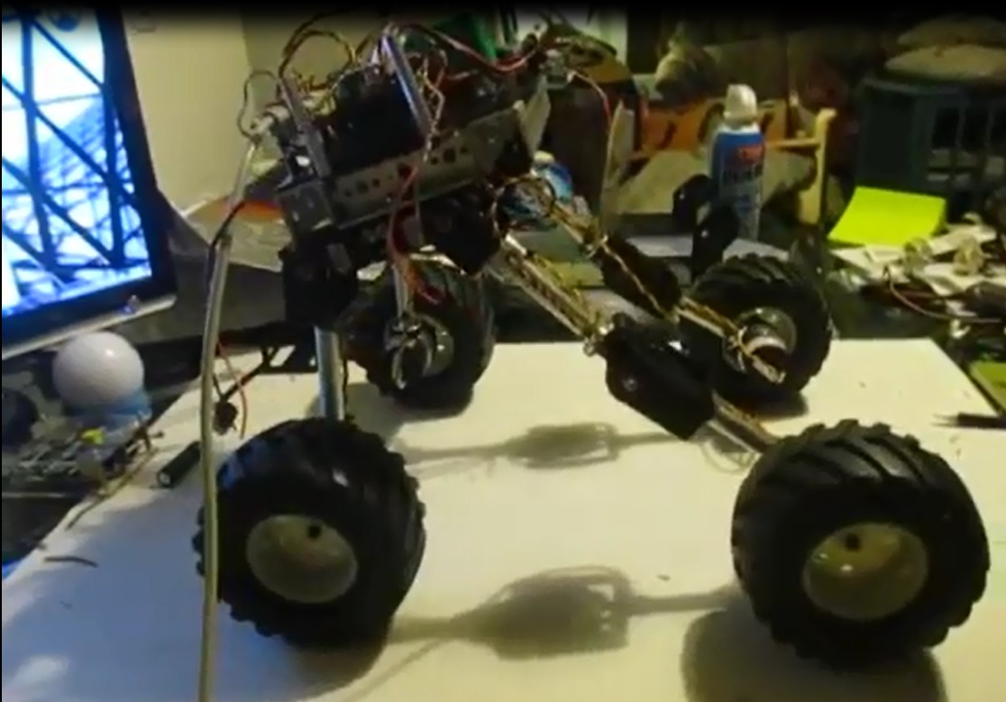
Stabilization Problem

Slide 3
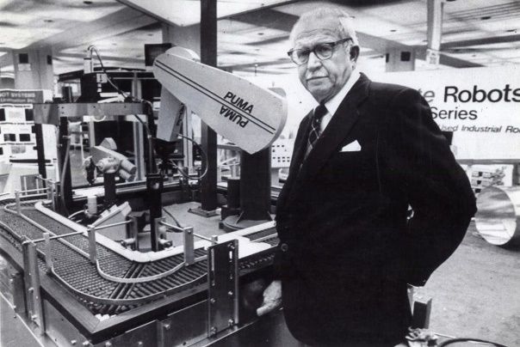
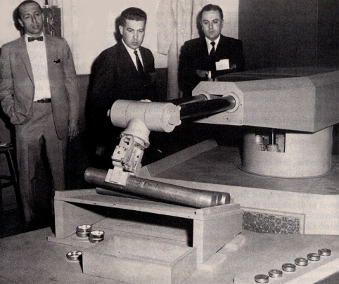
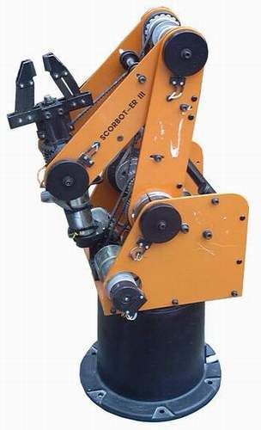
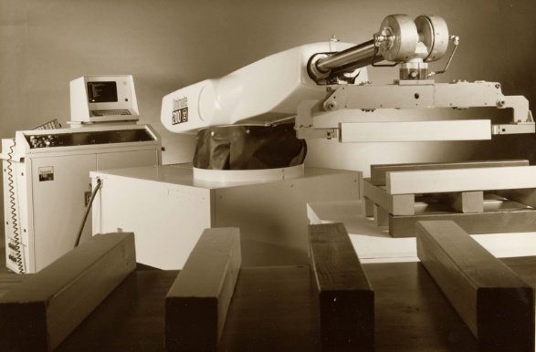

Robotic Arm History
The first programmable robot was designed by George Devol in 1954.
By 1962, GM automobile factory in New Jersey was the first to use an industrial robot.
In 1973 a German robotic company created the world’s first six electromechanically-driven axes called the “Famulus”.
The introduction of XRC controller in 1998 allowed user control up to 27 axes.

Slide 4
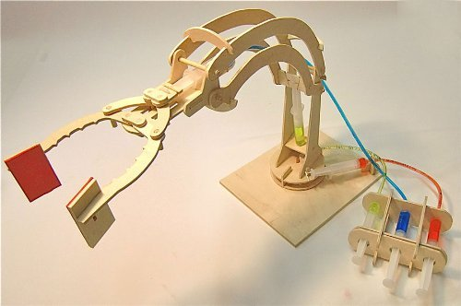
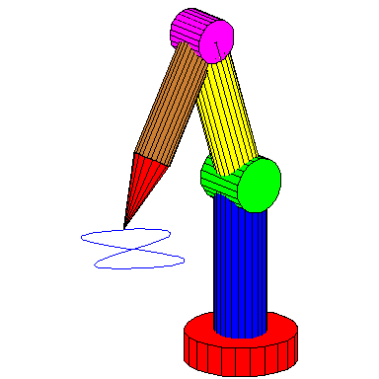
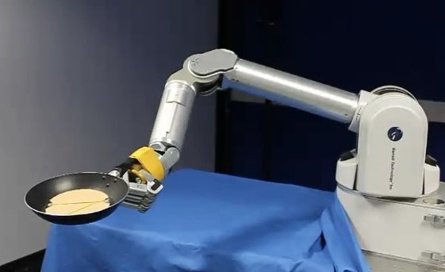
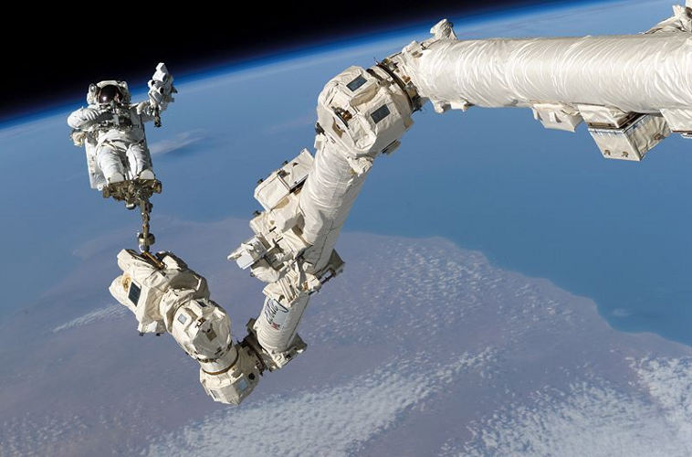
Facts about Robotic Arms
This technology is one of the most basic robot designs in the Robotic Engineering field.
The robotic arm has a wide range of applications with different challenging levels.
Requires a less amount of parts in order to put together, in comparison to the humanoid robot , quadruped robot, etc.
Uses basic math to understand the position of the arm as in real life.

Slide 5
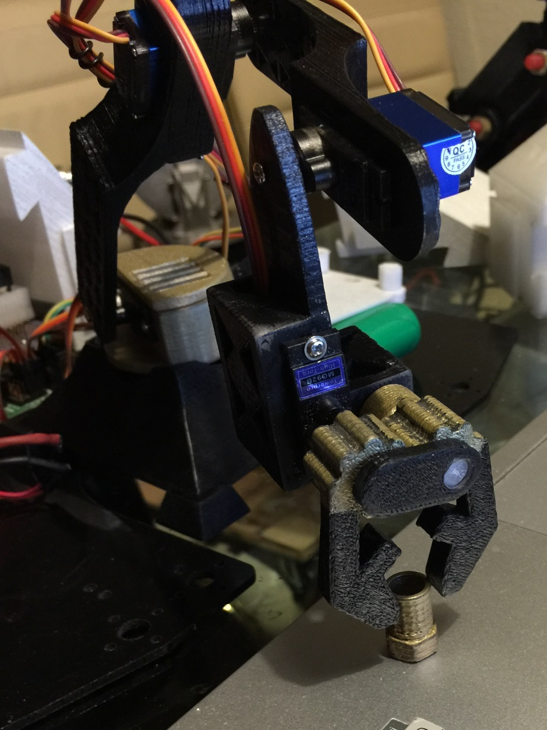
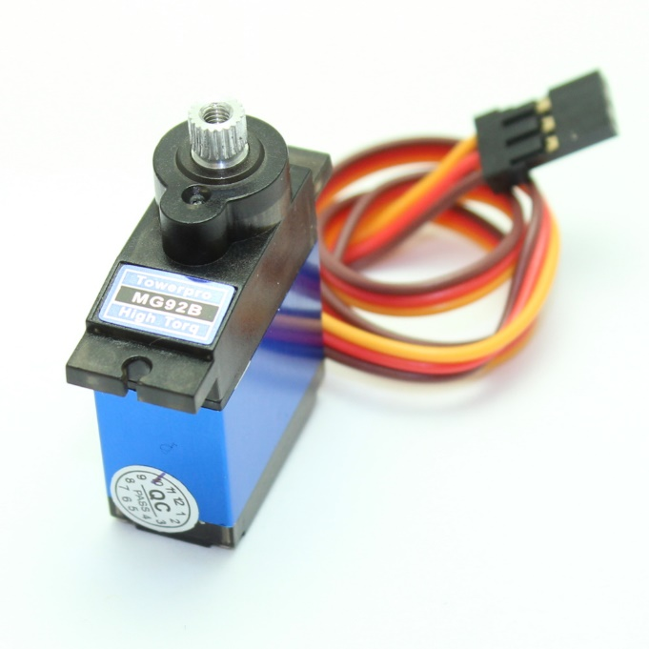
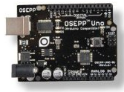
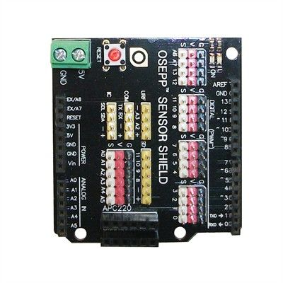
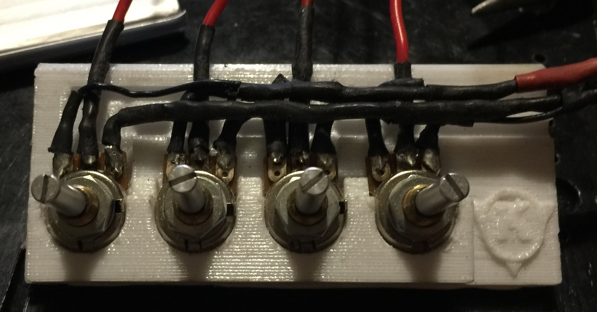
Plan of Attack
Understanding the Hardware .
Understanding the Software .
Understanding the Controller System.
Assemble the Circuits Specialists Robotic Arm.

Slide 6
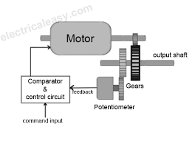
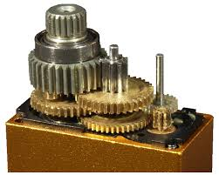
Understanding the Hardware
Info about OSEPP Uno Plus board.
Info about OSEPP Servo Shield.
Intro about servo motor:

Slide 7
Understand the Software
Inverse Kinematic
Code
Determine the joint parameters that provide a desired position of the end-effector.
The Cosine Law:
  A² = B² + C² – 2*B*C*cos(angleA)
  cos(angleA) = -(A² - B² - C² ) / (2*B*C)
  angleA = inverseCos[= -(A² - B² - C² ) / (2*B*C)]
b = sqrt(( x*x) +(y*y));
float angle_A1 = asin(y/b);
float angle_A2 = acos( - ( ( (a)*(a)) - ((b)*(b)) - ((c)*(c)) ) / (2*(b)*(c)) );
float angle_B = acos( - ( ( ((b)*(b)) - ((a)*(a)) - ((c)*(c)) )/ (2*(a)*(c)) )) ;
float angle_A = angle_A1+angle_A2;
angle_ADegree = (angle_A)*(180/PI) ; angle_BDegree = (angle_B)*(180/PI) ;

Slide 8
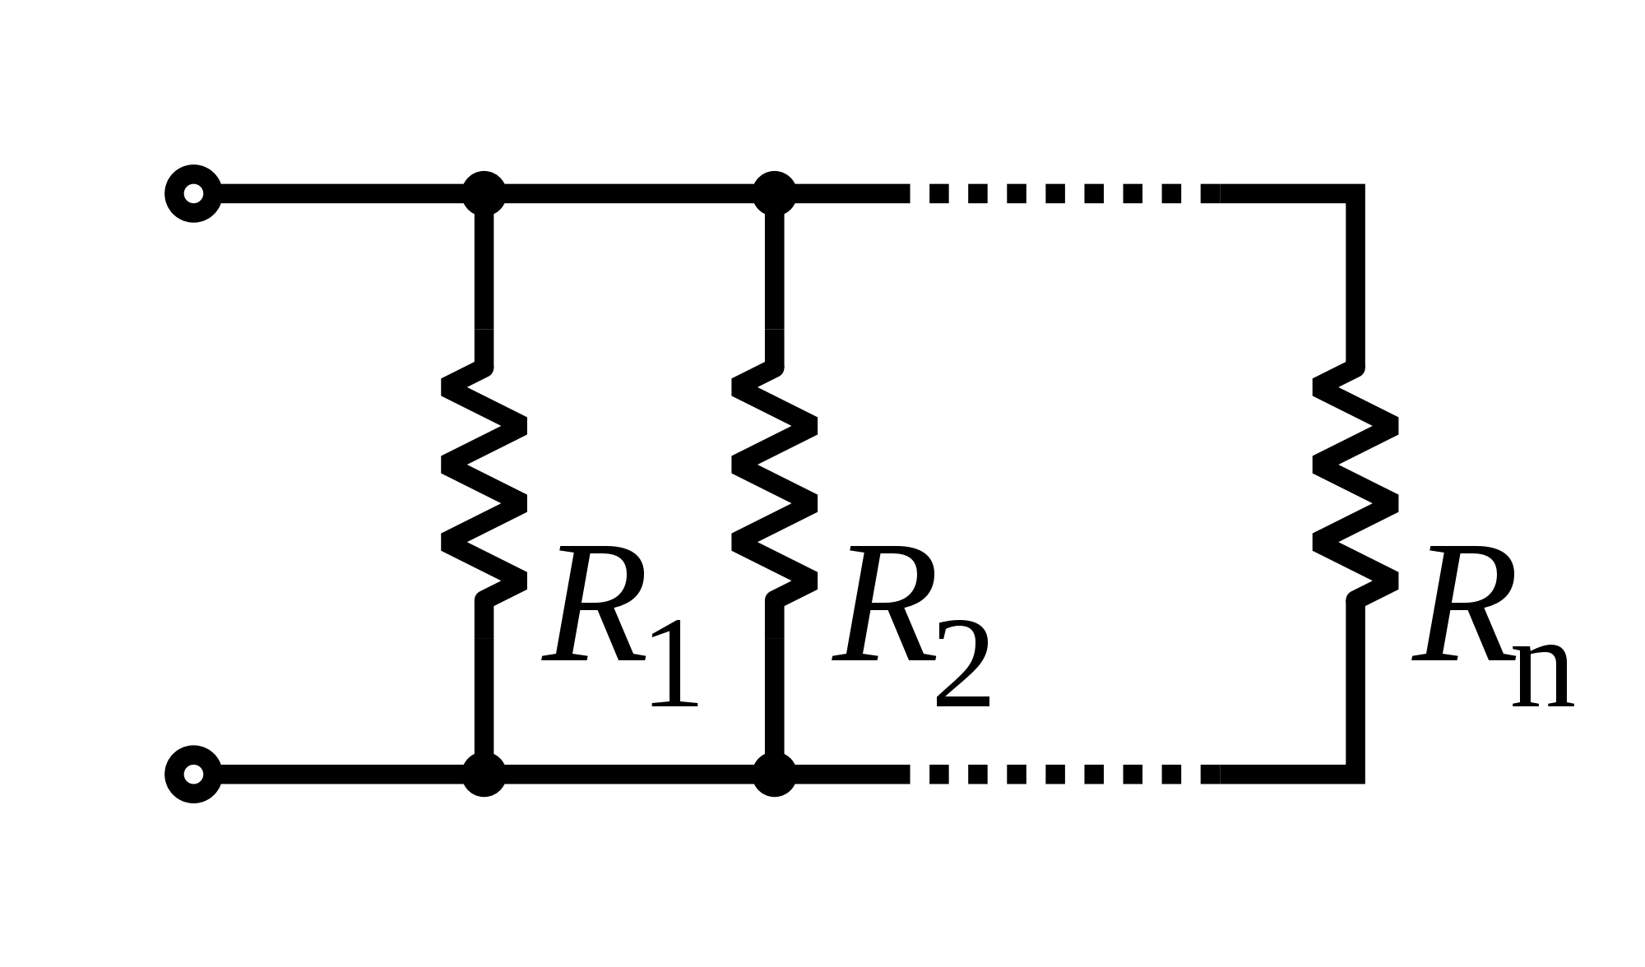
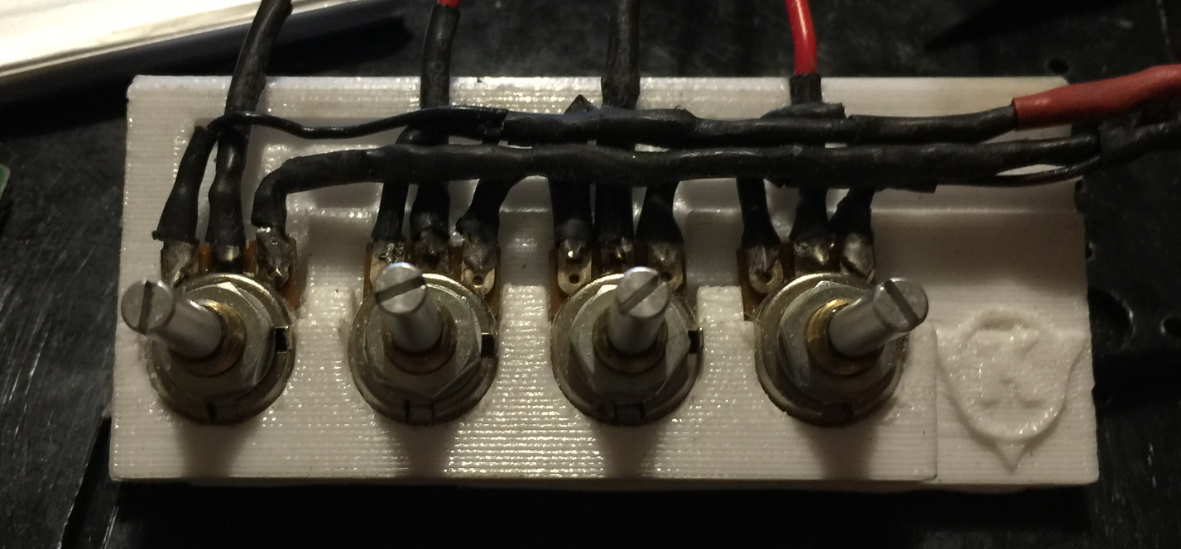
Understanding the Control System
Potentiometer measures the different voltage between 2 points.
Wire the potentiometer parallel to keep the voltage

Slide 9
Assemble the CSRA
Connect the servo in order:
Base Servo ---> pin 3
Rotation Servo ---> pin 4
Long Arm Servo ---> pin 5
Short Arm Servo ---> pin 6
Gripper Servo ---> pin 7
Then activated the homePos code prepare for assembly.

Slide 10
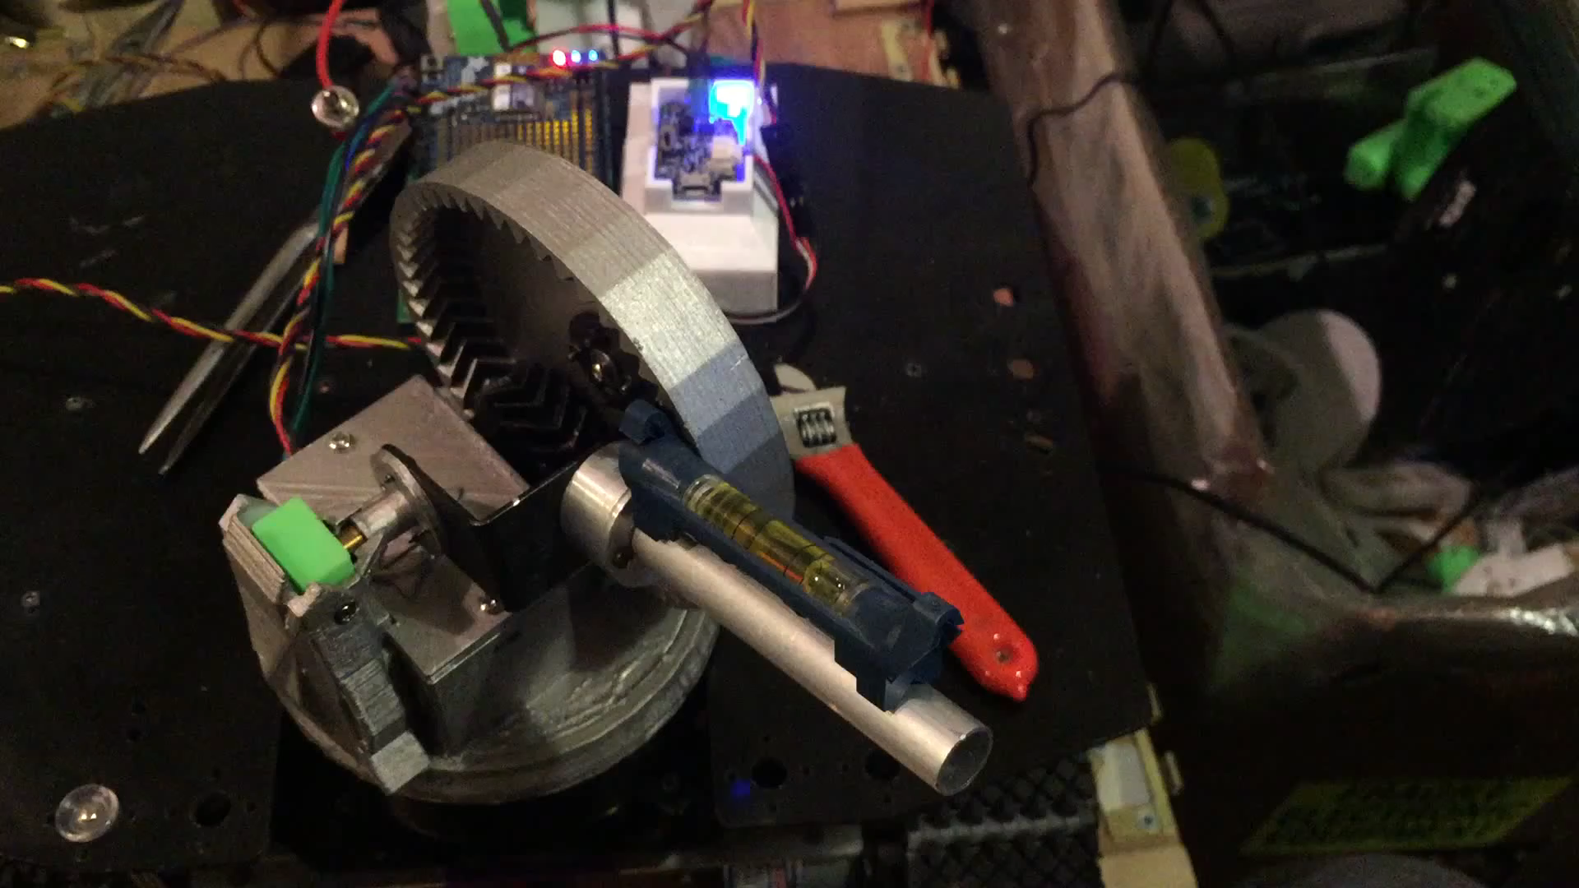
Q & A

